Slide 1
Lead Scoring Case Study Presentation SUBMISSION
Submitted by:
Aditya Varma

Slide 2
Abstract
Introduction: An education company named X Education sells online courses to industry professionals. On any given day, many professionals who are interested in the courses land on their website and browse for courses. The company markets its courses on several websites and search engines like Google. Once these people land on the website, they might browse the courses or fill up a form for the course or watch some videos. When these people fill up a form providing their email address or phone number, they are classified to be a lead. Moreover, the company also gets leads through past referrals. Once these leads are acquired, employees from the sales team start making calls, writing emails, etc. Through this process, some of the leads get converted while most do not. The typical lead conversion rate at X education is around 30%. The company requires a model wherein a lead score needs to be assigned to each of the leads such that the customers with higher lead score have a higher conversion chance and the customers with lower lead score have a lower conversion chance.
Method: The analysis was conducted on data which contains leads dataset from the past with around 9000 data points. This dataset consists of various attributes such as Lead Source, Total Time Spent on Website, Total Visits, Last Activity, etc. which may or may not be useful in ultimately deciding whether a lead will be converted or not. The target variable, in this case, is the column ‘Converted’ which tells whether a past lead was converted or not wherein 1 means it was converted and 0 means it wasn’t converted.

Slide 3
Problem solving methodology
Business understanding
Understanding
Data dictionary
Read “Leads.csv”
Identifying data quality issues
Selecting features using RFE
Standardizat-ion using standard scaling
Data preparation - Dummy variable creation
EDA &
Data cleaning
Model building
Model evaluation
Predicting on test set
Presentation to customer

Slide 4
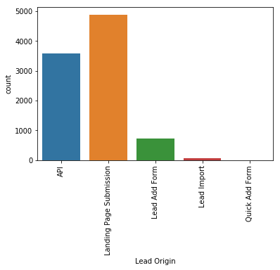
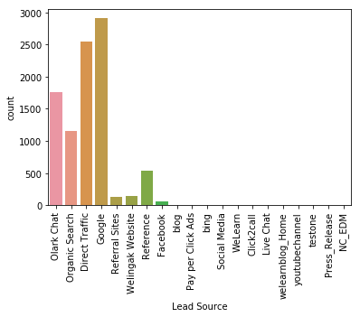
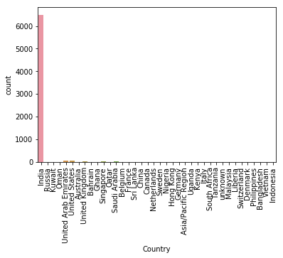
Exploratory Data Analysis – Univariate analysis
This univariate analysis is done to identify the top Lead Origin, Lead source & Country
Result: From the above visualization it is clear that
1. Landing page submission is top lead origin 2. Google is the top lead source 3. India is the top country which is contributing for leads

Slide 5
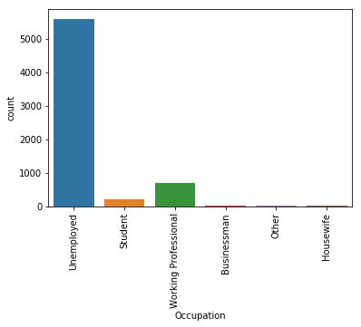
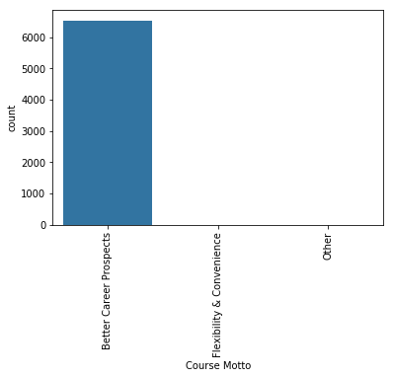
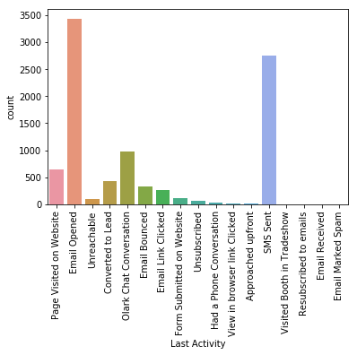
Exploratory Data Analysis – Univariate analysis
This univariate analysis is done to identify the top Occupation, Course Motto & Last Activity performed by customer
Result: From the above visualization it is clear that
1. Unemployed is top occupation 2. Better career prospects in top career motto 3. Email opened is the top Last Activity performed by customer

Slide 6
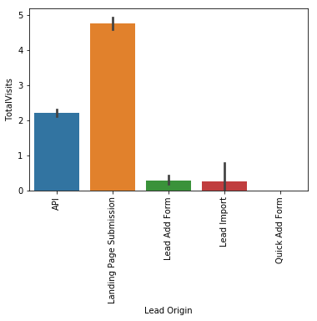
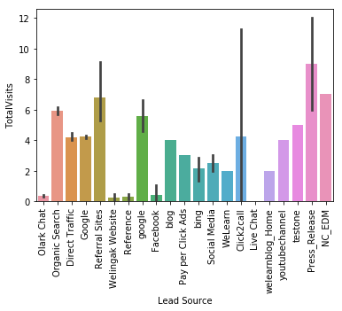
Exploratory Data Analysis – Bivariate analysis
This bivariate analysis is done to identify the top Lead Origin, Lead source w.r.t Total visits
Result: From the above visualization it is clear that Landing page submission is top lead origin and Press release it the top total visits contributing for leads w.r.t Total visits

Slide 7
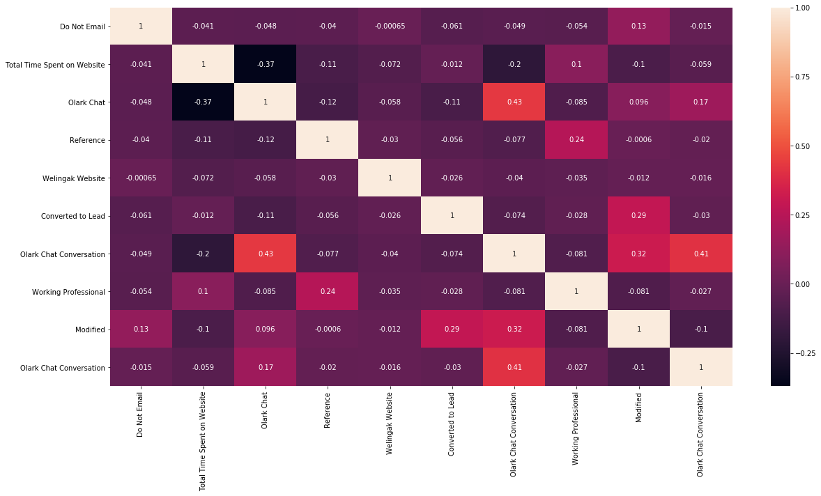
Covariance matrix
After selecting features using RFE and dropping the insignificant variables, We can plot covariance matrix as below to find the correlation among variables
Result: From above correlation plot it can be observed that correlations are very close to 0 for most of the variables. For 3 variables there is a minor correlation. But those have very less VIF so we can include these features in the model

Slide 8
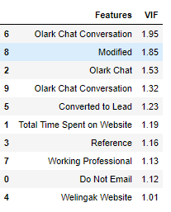
Variance Inflation Factor
VIF helps us to get more insights on the correlation.
Result: As per the aboe data we can conclude that the features that we included in the model has less VIF so we can consider all these features

Slide 9
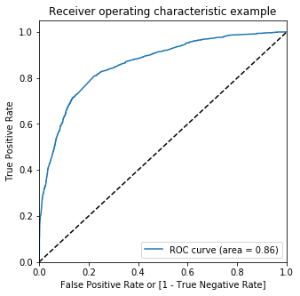
ROC Curve
We can also plot ROC Curve to check the performance of the classifier model built
Result: From the above curve we can see that the curve is closer to the left-hand border and then the top border of the ROC space so we can conclude that our model is accurate

Slide 10
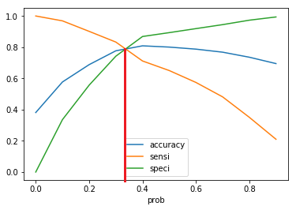
Finding Optimal Cutoff Point
Optimal cutoff point can be found by plotting Accuracy, Sensitivity & Specificity as below
Result: From above plot, 0.36 is the optimum point to take it as a cutoff probability.

Slide 11
Conclusions
Below are the variables which needs to concentrate more to the get the maximum number of lead conversions.
Lead source: Welingak Website, Reference & Olark chat are considered as most important factors. Apart from these, leads obtained from Google also has maximum number of lead conversions.
Occupation: Targeting Working professionals & Unemployed will have good lead conversion as they will be looking for better career prospects
When there is enough time to convert in to a Lead it is good to focus mainly on the customers which are having a Probability of conversion >0.36(36%) so we can put all our efforts on it do the Lead conversion aggressively and focus mainly on the Customers which are having Lead score(>40) and Conversion Probability(0.36).
When company reaches its target for a quarter before the deadline it is good to focus mainly on the Customers which are having high Lead score and Conversion Probability.(>80 and >0.8). This will reduce unnecessary phone calls.

Slide 12
Thank you

